Slide 1


A contact interaction model to study mesons
Marco Antonio Bedolla Hernández
COLLABORATORs
Khepani raya
Adnan Bashir
Elena santopinto
NONPERTURBATIVE QCD 2018, SEVILLA, SPAIN, November 2018

Slide 2
QCD and Hadron Physics
Schwinger-Dyson Equations
Quantum chromodynamics (QCD) it the theory of quarks, gluons and their interactions.
In particular, the way particles interact through strong interactions hides fascinating secrets, to be still found out in the next years.
Due to the theory running coupling constant particular behavior, studies on QCD are done in three regimes:
A light sector, where the interactions are mainly dominated by chiral symmetry breaking and a strong coupling.
A heavy sector, where the coupling tends to approach asymptotic freedom and the systems can be treated in a non relativistic way.
Notes:
Lamentablemente, estos fenómenos no son obvios de lagrangiano de QCD. Sin estos QCD sería igual que QED, pero las interacciones entre tres y cuatro gluones estos fenómenos bastante interesantes

Slide 3
QCD and Hadron Physics
Schwinger-Dyson Equations
A transition region, where the dynamics goes from the regime of chiral dynamics to the heavy sector symmetries.
In order to study this bridge, we study the QCD simplest bound states: mesons.
We use the Schwinger-Dyson equations (SDEs) of quantum chromodynamics. They provide a natural means to study the different QCD regions.
Earlier studies of QCD through SDEs with refined truncations are a brute force numerical evaluation, which stops short of exploring the large momentum transfer region.
We present a simple momentum independent contact interaction (CI) model, which provides a simple scheme to exploratory studies on QCD.
Notes:
Lamentablemente, estos fenómenos no son obvios de lagrangiano de QCD. Sin estos QCD sería igual que QED, pero las interacciones entre tres y cuatro gluones estos fenómenos bastante interesantes

Slide 4
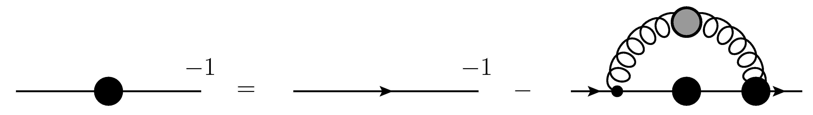
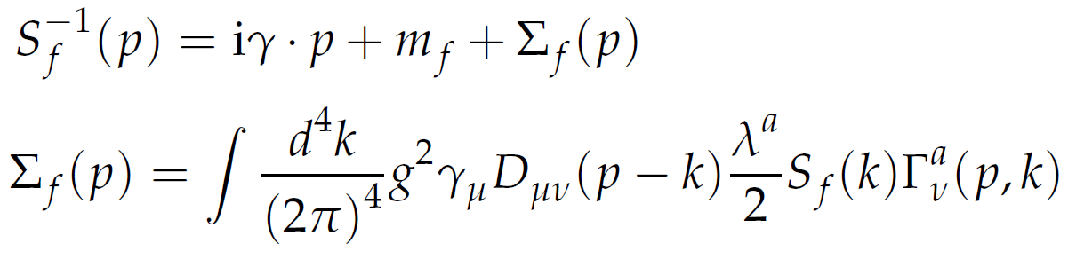
QCD and Hadron Physics
Schwinger-Dyson Equations
Quark SDE:
Mathematical expression:
Notes:
El propagador vestido del quark se escribe como el propagador desnudo más los términos de autointeracción. Aquí tenemos las correcciones al propagador del quark, las correcciones al vértice y las correccones al propagador del gluón

Slide 5
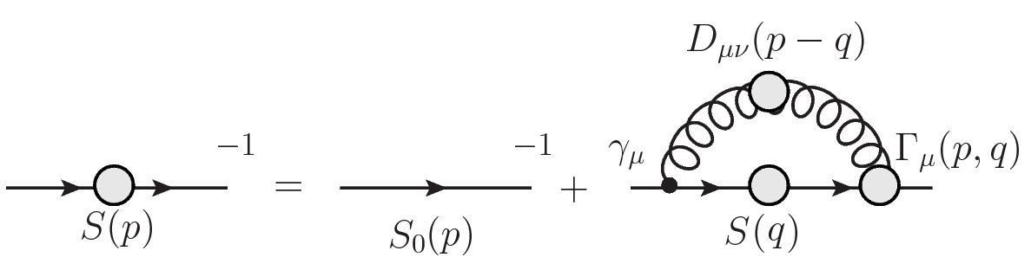
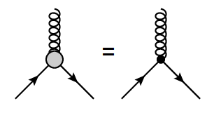
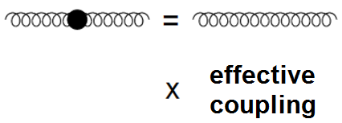
QCD and Hadron Physics
Schwinger-Dyson Equations
In order to solve the SDE, we employ a truncation scheme:
Rainbow truncation:
Notes:
La ecuación de Schwinger-Dyson no se puede resolver hasta que se define un problema manejable. Para ello se hace un modelo para el gluón, donde por lo general se considera el gluón libre multiplicado por un acoplamiento efectivo que reuna las propiedades de QCD. Al mismo tiempo para el vértice, donde usualmente se toma el vértice desnudo. Nosotros las truncamos a primer orden. Y los efectos de QCD se incluyen en el acoplamiento efectivo.

Slide 6
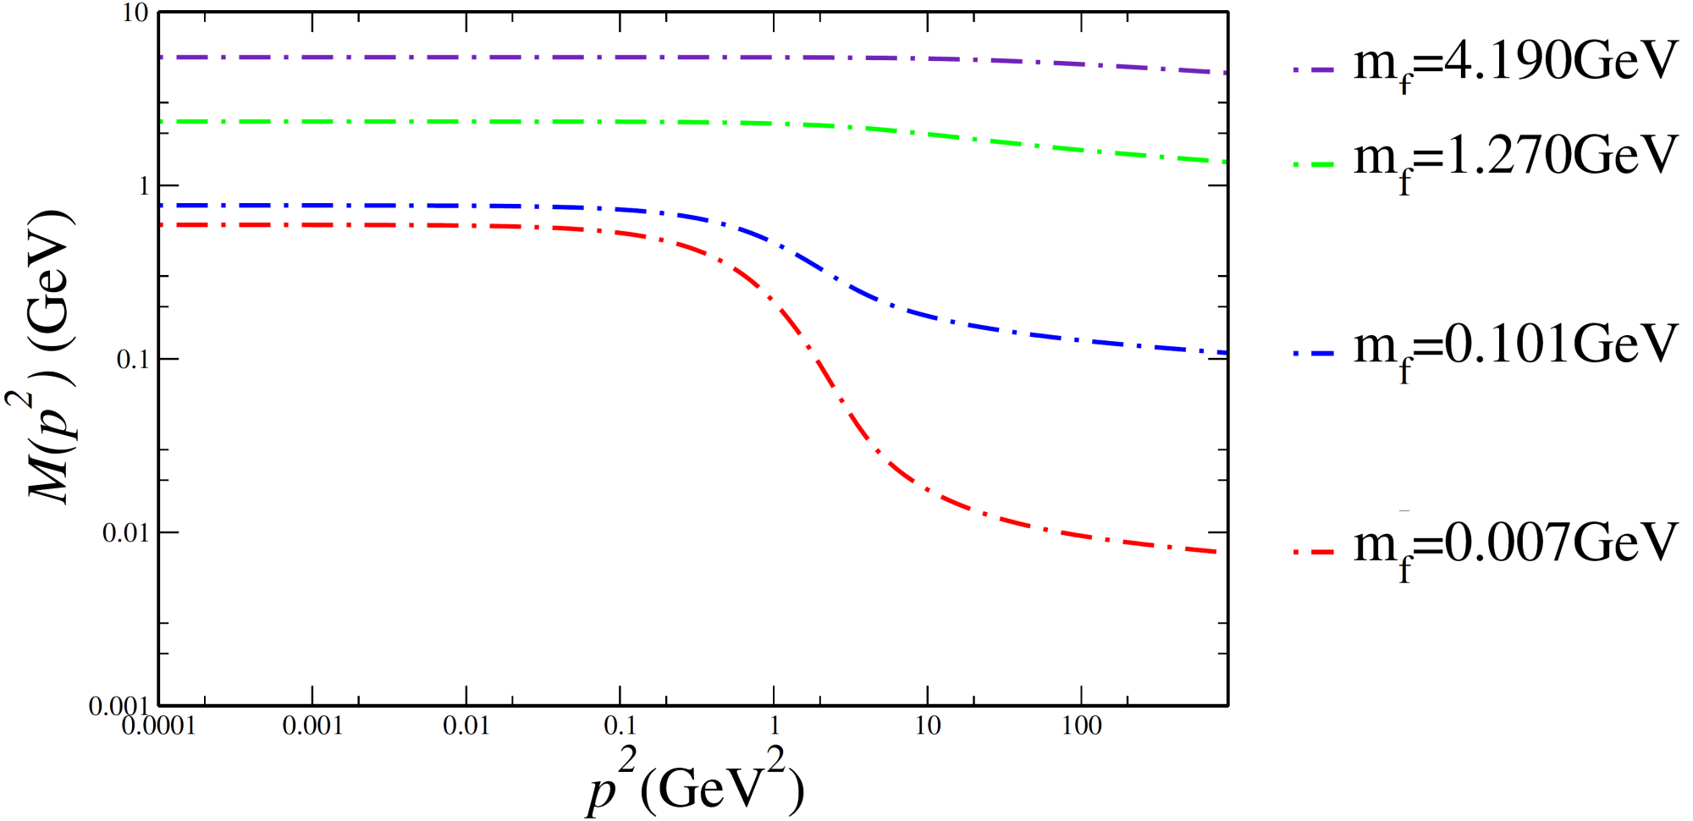
QCD and Hadron Physics
Schwinger-Dyson Equations
Mass function for different quark masses.
P. Maris and P. C. Tandy Phys. Rev. C60, 055214 (1999)
Notes:
Mientras más pequeña es la masa, los efectos de las autointeracciones influyen más en la adquisición de masa dinámica del quark, los quarks pesados no sienten tanta influencia. Dicho de otra manera, los quarks pesados no se ven afectados por la masa del gluón

Slide 7
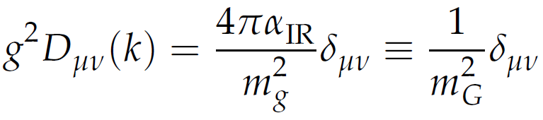


Contact Interaction
We use a contact interaction model mediated by a vector-vector interaction employed in:
L. Xiomara Gutiérrez, et. al., Phys. Rev. C81, 065202 (2010);
H.L.L Roberts, et. al. Phys. Rev. C82, 065202 (2010);
Phys. Rev. C83, 065206 (2011).
This model provides a simple scheme to exploratory studies of the spontaneous chiral symmetry breaking and its consequences like:
  Dynamical mass generation.
  Quark condensate.
  Goldstone bosons in chiral limit.
  Confinement.
Notes:
It a model which is independent of relative momentum
En el segundo se calcula para el meson rho

Slide 8
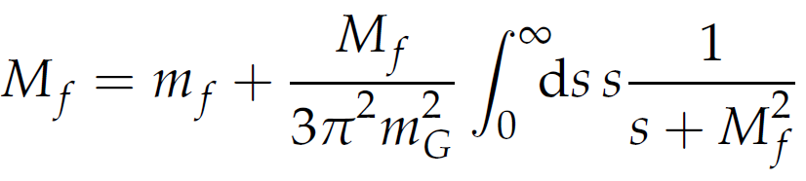
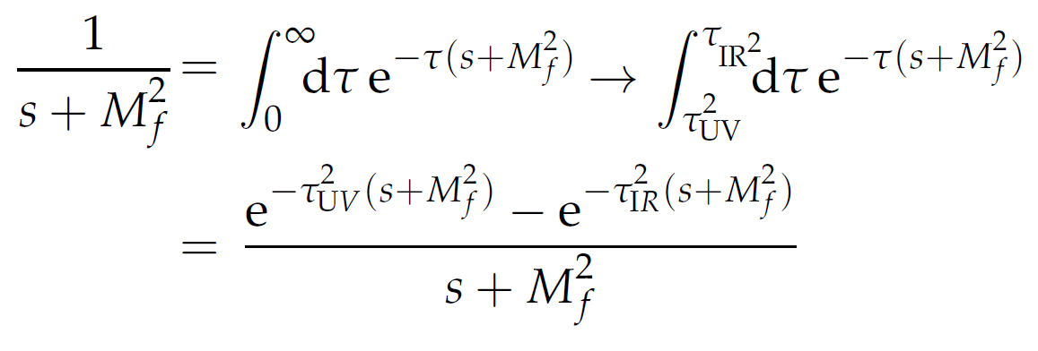
Contact Interaction
Mass function:
Proper time
regularization:
The constant τ_{UV} is the regulator since the model is not renormalizable and cannot been removed. This regulator plays a dynamical role and sets the scale of dimensioned quantities.
A non zero value of τ_{IR} implements confinement by ensuring the absence of quark production threshold at s=-M²_{f} .
Notes:
Tau ir diferente de cero implementa confinamiento al eliminar el polo, tau uv es el regulador, no puede ser eliminado pero juega un rol dinámico y ajusta la escala para nuestras dimensiones

Slide 9
Contact Interaction
M.A. Bedolla, et. al Phys. Rev. D 92, 054031 (2015).
M.A Bedolla, et. al. Phys. Rev. D 93, 094025 (2016).
The leptonic decay constant is highly influenced by the high momentum tail of the quark mass function.
This high momentum region probes the wave function at the origin.
The CI yields constant dressing functions with no perturbative tail.
By increasing the mass of heavy quarks, quarkonuim becomes increasingly point like—and the closer the quarks, the smaller the interaction between them.
We need to reduce the effective interaction strength for the ci to extend to the heavy quarks sector.
A reduction in the strength of the kernel has to be compensated by an increased ultraviolet cutoff.

Slide 10
Light mesons: masses and decay constants
C. Chen, et. al. Few Body Syst. 53, 293 (2012).
Few Body Syst. 51, 1 (2011).
M_{u}=139 | Λ_{UV}=905 | Λ_{IR}=240 | m_{u,d}=7 | α_{IR}=0.93π
Masses in MeV | m_{π}(1S) | m_{ρ}(1S) | m_{σ}(1P) | m_{a1}(1P)
PDG(2016) | 140 | 780 | 1000-1200 | 1230
Contact Interaction | 140 | 930 | 1290 | 1380
Decay Constants (GeV) (g_{so}=0.24)
PDG(2016) | 130 | 152
Contact Interaction | 101 | 129
Bethe-Salpeter Amplitudes
E_{H} | 3.593 | 1.530 | 0.472 | 0.309
F_{H} | 0.474
Charge-Radii (fm)
PDG(2016) | 0.672
Contact Interaction | 0.450
Notes:
El resto se ajustó para tener en el límite chiral Mpi=0.4GeV, Mrho=0.78 fpi=0.088, frho=0.15, kpi=0.22 con error del 13%

Slide 11
Charm mesons: masses and decay constants
M.A. Bedolla, et. al Phys. Rev. D 92, 054031 (2015).
M.A Bedolla, et. al. Phys. Rev. D 93, 094025 (2016).
M_{c}=1482 | Λ_{UV}=2.400 | Λ_{IR}=240 | m_{c}=1090 | α_{IR}=0.172
Masses in MeV | m_{ηc}(1S) | m_{J/Ψ} (1S) | m_{χc0}(1P) | m_{χc1}(1P)
PDG(2016) | 2983 | 3096 | 3414 | 3510
Contact Interaction | 2976 | 3090 | 3374 | 3400
Decay Constants (MeV) (g_{so}=0.24)
PDG(2016) | 238 | 294
Contact Interaction | 255 | 206
Bethe-Salpeter Amplitudes
E_{H} | 2.156 | 0.612 | 0.051 | 0.028
F_{H} | 0.406
Charge-Radii (fm)
SDE(2017) | 0.219
Contact Interaction | 0.250
Notes:
El resto se ajustó para tener en el límite chiral Mpi=0.4GeV, Mrho=0.78 fpi=0.088, frho=0.15, kpi=0.22 con error del 13%

Slide 12
Bottom mesons: masses and decay constants
K. Raya, et. al Few Body Syst. 59 (2018) no.6, 133
M_{b}=4700 | Λ_{UV}=6400 | Λ_{IR}=240 | m_{b}=3800 | α_{IR}=0.023
Masses in MeV | m_{ηb}(1S) | m_{Υ}(1S) | m_{χb0}(1P) | m_{χb1}(1P)
PDG(2016) | 9400 | 9460 | 9860 | 9892
Contact Interaction | 9407 | 9547 | 9671 | 9680
Decay Constants (MeV) (g_{so}=0.24)
PDG(2016) | ---- | 506
Contact Interaction | 553 | 219
Bethe-Salpeter Amplitudes
E_{H} | 0.851 | 0.184 | 0.001 | 0.0008
F_{H} | 0.173
Charge-Radii (fm)
SDE(2017) | 0.086
Contact Interaction | 0.109
Notes:
El resto se ajustó para tener en el límite chiral Mpi=0.4GeV, Mrho=0.78 fpi=0.088, frho=0.15, kpi=0.22 con error del 13%

Slide 13
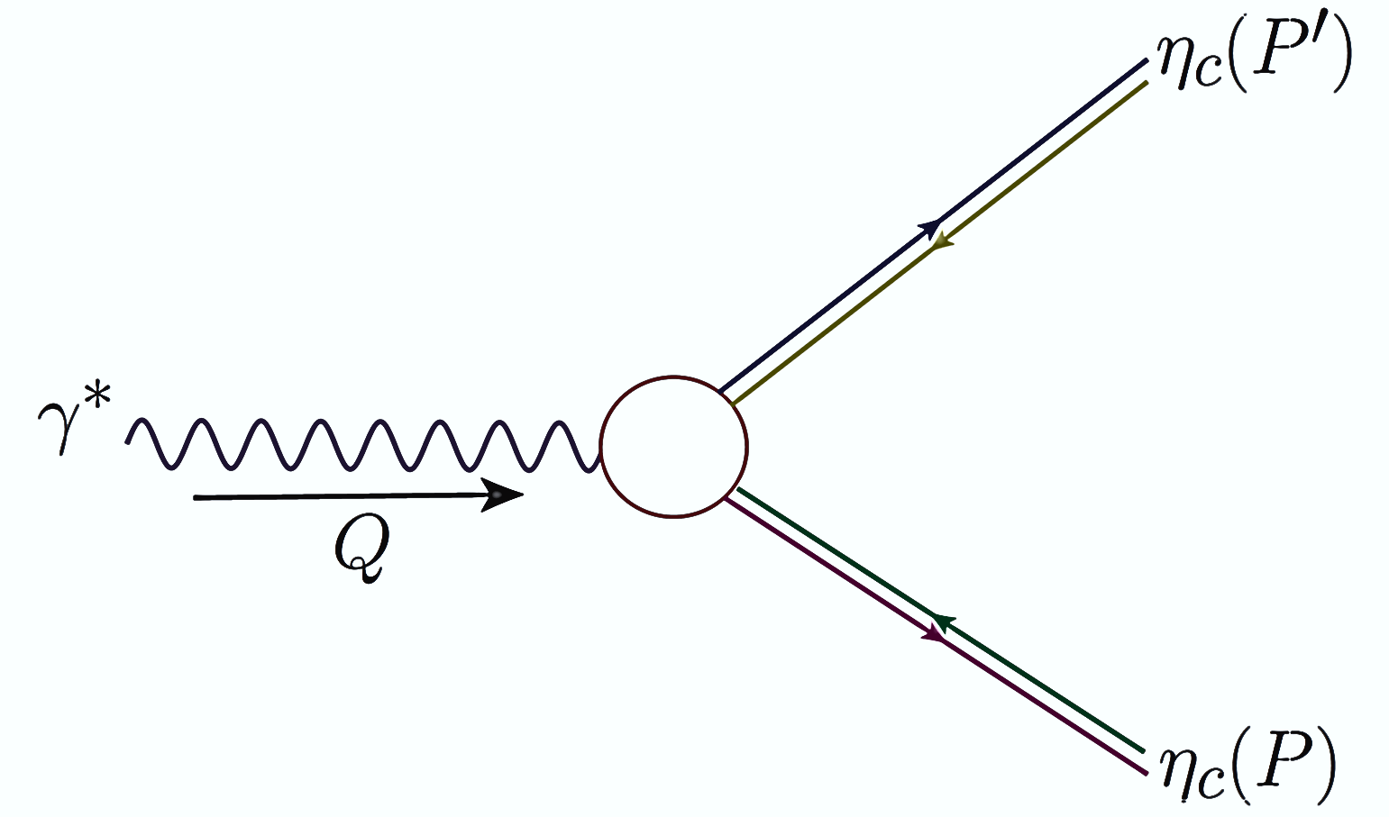
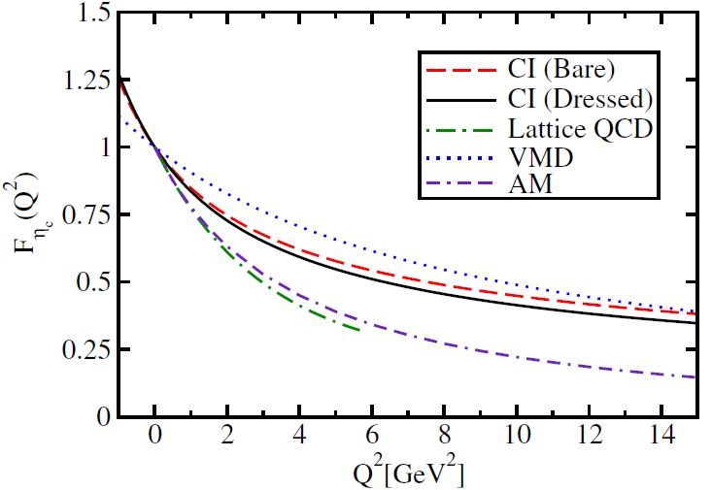
Elastic Form Factor
M.A Bedolla, et. al Phys. Rev. D 93, 094025 (2016).
Charge Radii
Dyson-Schwinger Equations | 0.219fm
Lattice | 0.25fm
Contact Interaction | 0.21fm
VMD | 0.156fm
Algebraic Model | 0.256fm

Slide 14
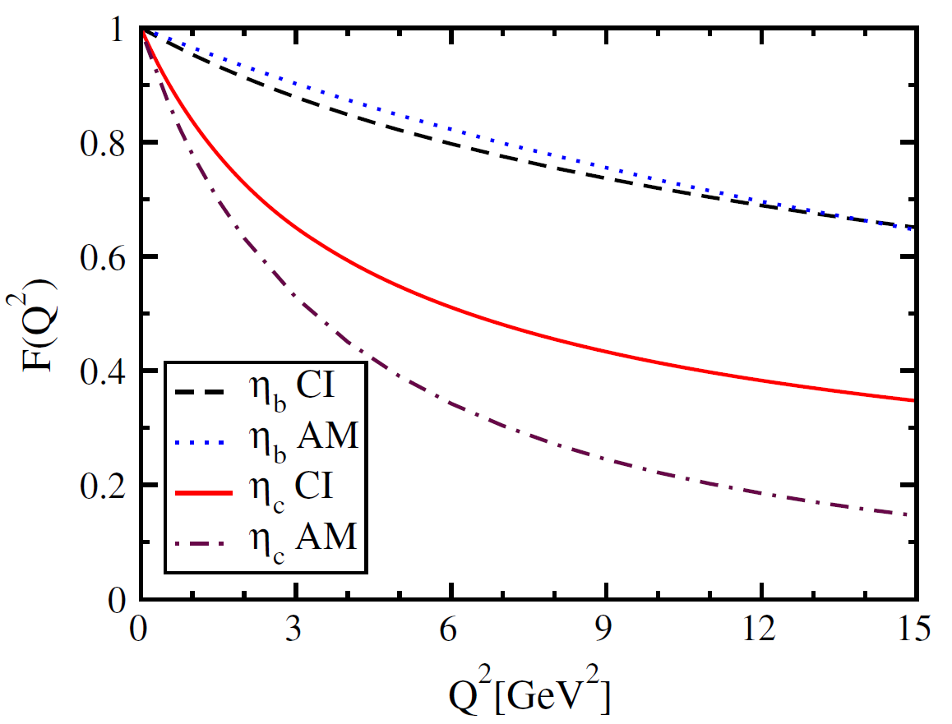
Elastic Form Factor
K. Raya, et. al Few Body Syst. 59 (2018) no.6, 133
Charge Radii
η_{b} | 0.107fm
η_{c} | 0.210fm

Slide 15
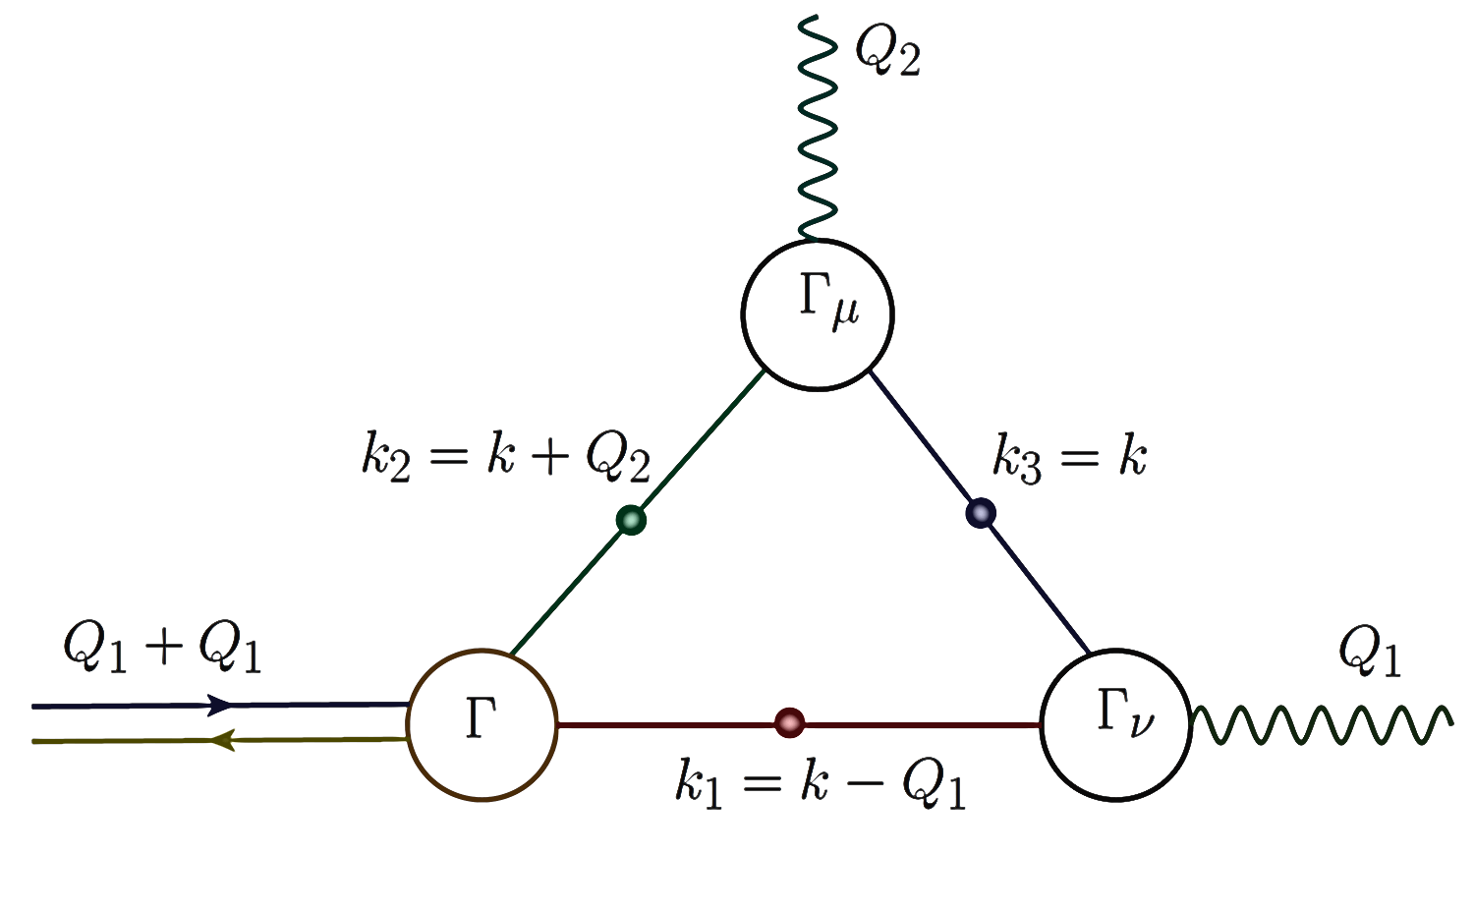
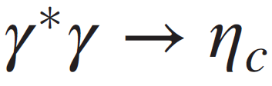
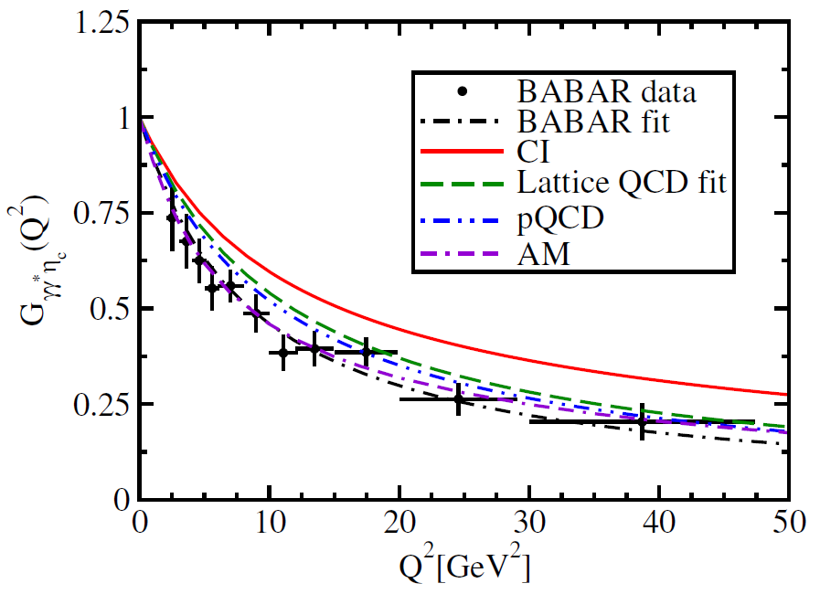
Transition Form Factor
M.A Bedolla, et. al. Phys. Rev. D 93, 094025 (2016).
Interaction Radii
BABAR | 0.166fm
Lattice | 0.141fm
Contact Interaction | 0.133fm
Algebraic Model | 0.170fm

Slide 16
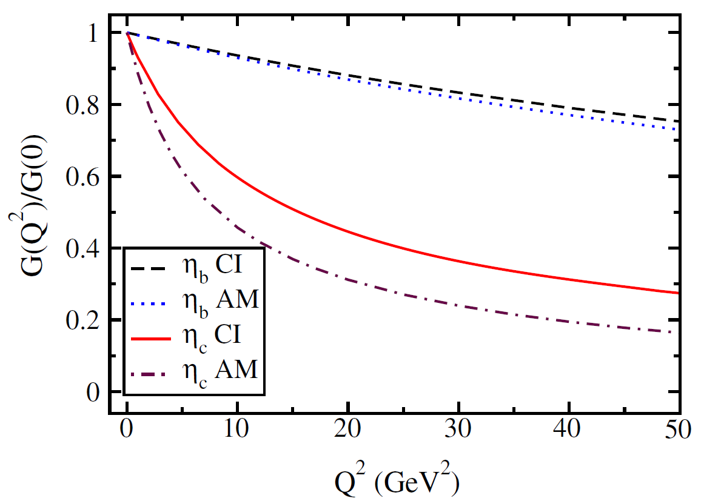
Transition Form Factor
K. Raya, et. al Few Body Syst. 59 (2018) no.6, 133
Interaction Radii
Dyson-Schwinger Equations | 0.041fm
Contact Interaction | 0.043fm

Slide 17
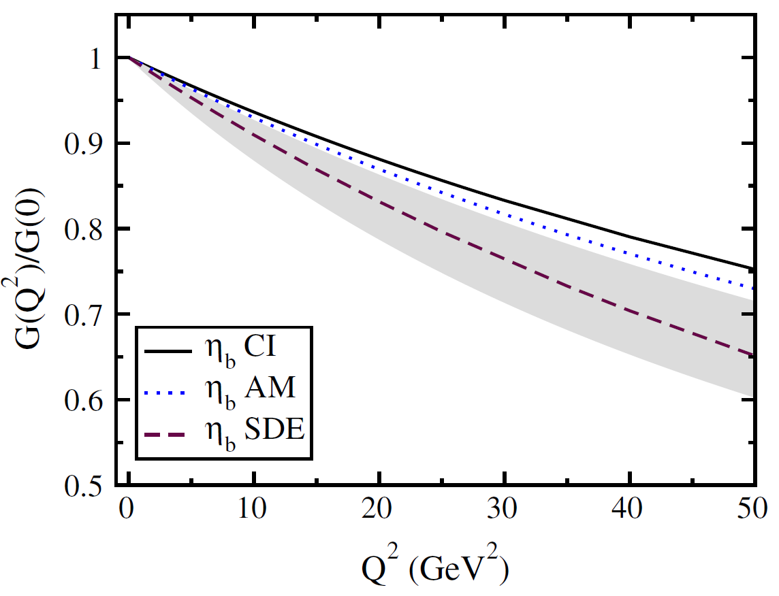
Transition Form Factor
K. Raya, et. al Few Body Syst. 59 (2018) no.6, 133
K. Raya, M. Ding et. al Phys. Rev. D 95, 074014.
Interaction Radii
Dyson-Schwinger Equations | 0.041fm
Contact Interaction | 0.043fm

Slide 18
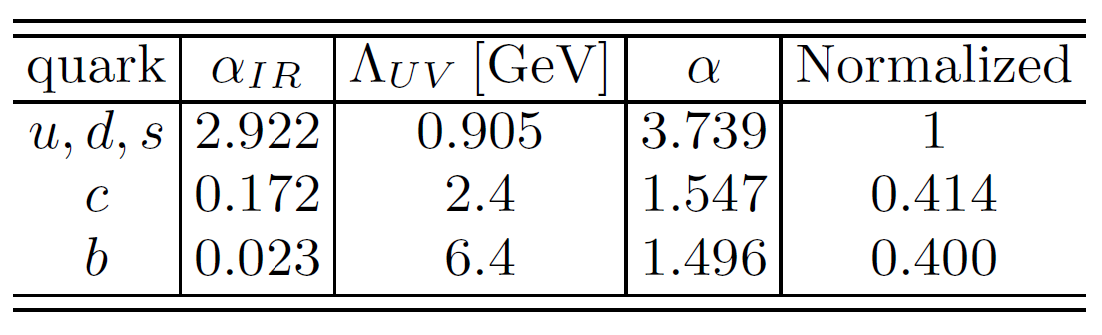
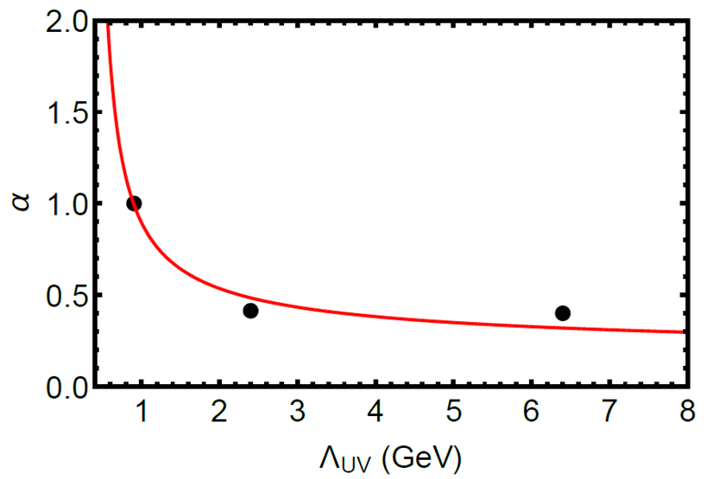
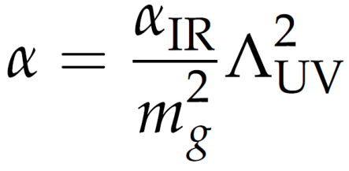


Contact Interaction
K. Raya, et. al Few Body Syst. 59 (2018) no.6, 133
Let’s define a dimensionless coupling constant.
Notes:
Para hacerlo momentum dependance, dividimos por mg^2 para así poder tener una dependencia con Lambda ^2

Slide 19
mesons: masses and decay constants
D
M.A. Bedolla and E. Santopinto arXiv:1810.04391 [hep-ph].
M_{c}=1451, M_{u}=49 | Λ_{UV}=1905 | Λ_{IR}=0.24 | m_{c}=1090, m_{u}=7 | α_{IR}=0.363
Masses in MeV | m_{D}(1S) | m_{D*} (1S) | m_{D0}(1P) | m_{D1}(1P)
PDG(2016) | (1864, 149) | (2010, 196) | 2318 | 2420
Contact Interaction | (1869, 425) | (2046, 182) | 2347 | 2422
Serna (2017) | (1869, 146) | (2011, 169) | ----- | -----
Nguyen (2011) | (1850, 108) | (2040, 113)
Nguyen (2011) | (1880, 183) | ------
Hilger (2016) | (1868, 228) | ------
Hilger (2016) | (1869, 678) | ------
Bethe-Salpeter Amplitudes
E_{H} | 4.292 | 0.592 | 0.073 | 0.039
F_{H} | 0.064 | ----- | ----- | -----
Notes:
Ladina´mica del gluón no se afecta por la masa de quarks pesados
EL corte infrarrojo es una indicación de acoplamiento.

Slide 20
mesons: masses and decay constants
D_{s}
M.A. Bedolla and E. Santopinto arXiv:1810.04391 [hep-ph].
M_{c}=1451, M_{s}=521 | Λ_{UV}=1905 | Λ_{IR}=0.24 | m_{c}=1090, m_{s}=170 | α_{IR}=0.363
Masses in MeV | m_{D}(1S) | m_{D*} (1S) | m_{D0}(1P) | m_{D1}(1P)
PDG(2016) | (1968, 176) | (2112, 227) | 2318 | 2420
Contact Interaction | (1983, 247) | (2194, 192) | 2442 | 2487
Serna (2017) | (1977, 169) | (2098, 195) | ----- | -----
Nguyen (2011) | (1970, 139) | (2040, 113)
Nguyen (2011) | (1900, 194) | ------
Hilger (2016) | (1872, 190) | (2175, 125)
Hilger (2016) | (1802, 208) | ------
Bethe-Salpeter Amplitudes
E_{H} | 2.450 | 0.670 | 0.069 | 0.037
F_{H} | 0.302 | ----- | ----- | -----
Notes:
Ladina´mica del gluón no se afecta por la masa de quarks pesados
EL corte infrarrojo es una indicación de acoplamiento.

Slide 21
mesons: masses and decay constants
B
M.A. Bedolla and E. Santopinto arXiv:1810.04391 [hep-ph].
M_{b}=4575, M_{u}=14 | Λ_{UV}=6605 | Λ_{IR}=0.24 | m_{b}=3800, m_{u}=7 | α_{IR}=0.017
Masses in MeV | m_{B}(1S) | m_{B*} (1S) | m_{B0}(1P) | m_{B1}(1P)
PDG(2016) | (5279, 186) | (5325, 175) | ----- | 5725
Contact Interaction | (5273, 129) | (5314, 371) | 5660 | 5704
Nguyen (2011) | (5270, 74) | (5150, 187) | ----- | -----
Nguyen (2011) | (1850, 108) | (2040, 113)
Bethe-Salpeter Amplitudes
E_{H} | 0.143 | 0.149 | 0.002 | 0.001
F_{H} | 0.0002 | ----- | ----- | -----
Notes:
Ladina´mica del gluón no se afecta por la masa de quarks pesados
EL corte infrarrojo es una indicación de acoplamiento.

Slide 22
mesons: masses and decay constants
B_{s}
M.A. Bedolla and E. Santopinto arXiv:1810.04391 [hep-ph].
M_{b}=4616, M_{s}=331 | Λ_{UV}=6905 | Λ_{IR}=0.24 | m_{b}=3800, m_{s}=170 | α_{IR}=0.015
Masses in MeV | m_{Bs}(1S) | m_{Bs*} (1S) | m_{Bs0}(1P) | m_{Bs1}(1P)
PDG(2016) | (5366, 224) | (5415, 213) | ----- | 5828
Contact Interaction | (5376, 178) | (5414, 384) | 5767 | 5808
Nguyen (2011) | (5380, 101) | (5420, 113) | ----- | -----
Nguyen (2011) | (4750, 115) | -----
Bethe-Salpeter Amplitudes
E_{H} | 0.176 | 0.141 | 0.002 | 0.001
F_{H} | 0.007 | ----- | ----- | -----
Notes:
Ladina´mica del gluón no se afecta por la masa de quarks pesados
EL corte infrarrojo es una indicación de acoplamiento.

Slide 23
mesons: masses and decay constants
B_{c}
M.A. Bedolla and E. Santopinto arXiv:1810.04391 [hep-ph].
M_{b}=4381, M_{c}=1.827 | Λ_{UV}=5105 | Λ_{IR}=0.24 | m_{b}=3800, m_{c}=1090 | α_{IR}=0.034
Masses in MeV | m_{Bs}(1S) | m_{Bs*} (1S) | m_{Bs0}(1P) | m_{Bs1}(1P)
PDG(2016) | (6275, 427) | (----, 422) | ----- | -----
Contact Interaction | (6281, 420) | (6320, 220) | 6571 | 6596
Nguyen (2011) | (6360, 148) | (6440, 127) | ----- | -----
Nguyen (2011) | (5830, 320) | -----
Fischer (2015) | (6354, ---)
Hilger (2017) | (6608, 306) | (6690, 273)
Gómez-Rocha(2017) | (6275, ---) | (6690, ---)
Bethe-Salpeter Amplitudes
E_{H} | 1.026 | 0.149 | 0.002 | 0.001
F_{H} | 0.007 | ----- | ----- | -----
Notes:
Ladina´mica del gluón no se afecta por la masa de quarks pesados
EL corte infrarrojo es una indicación de acoplamiento.

Slide 24
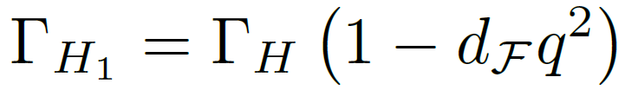
Excited States
C. Chen, et. al. Few Body Syst. 53, 293 (2012).
Few Body Syst. 51, 1 (2011).
In quantum mechanics the radial wave function for the first radial excitation posseses a single zero
In the SDBSE approach a single zero is seen in the relative momentum dependence of the leading Tchebychev moment of the dominant Dirac structure.
For this reason, a radial excitation cannot appear when the interaction between quarks is momentum independent.
We verge this inconvenient by inserting a zero into the kernel
The presence of this zero reduces the coupling in the BSE and therefore, it increases the bound-state’s mass

Slide 25
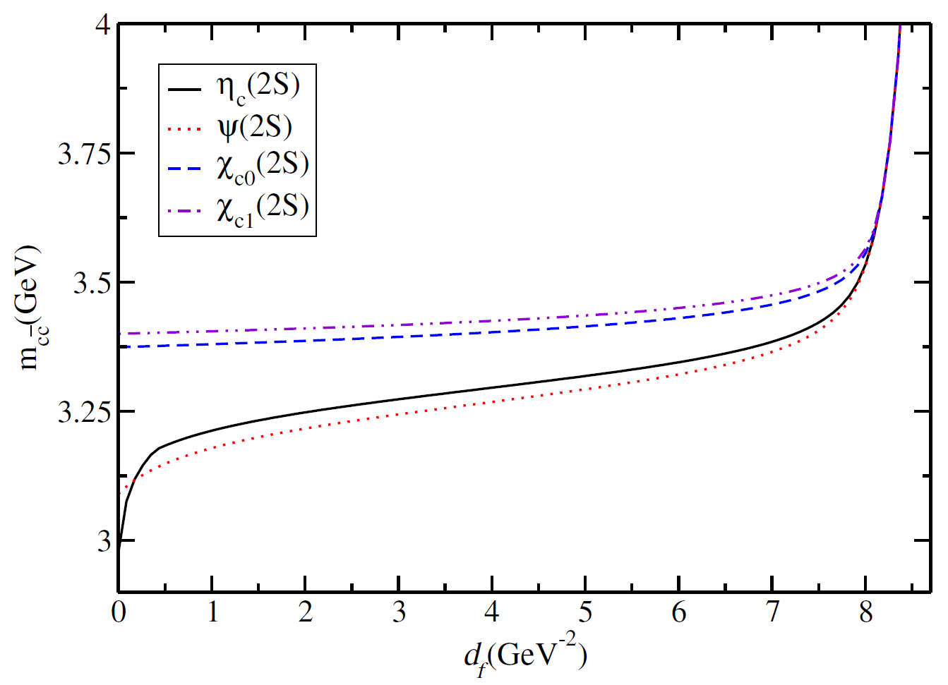
Excited States
M.A. Bedolla and E. Santopinto arxiv.org/abs/1807.01886v1
The evolution of the radial excitation’s mass with respect to the parameter:

Slide 26
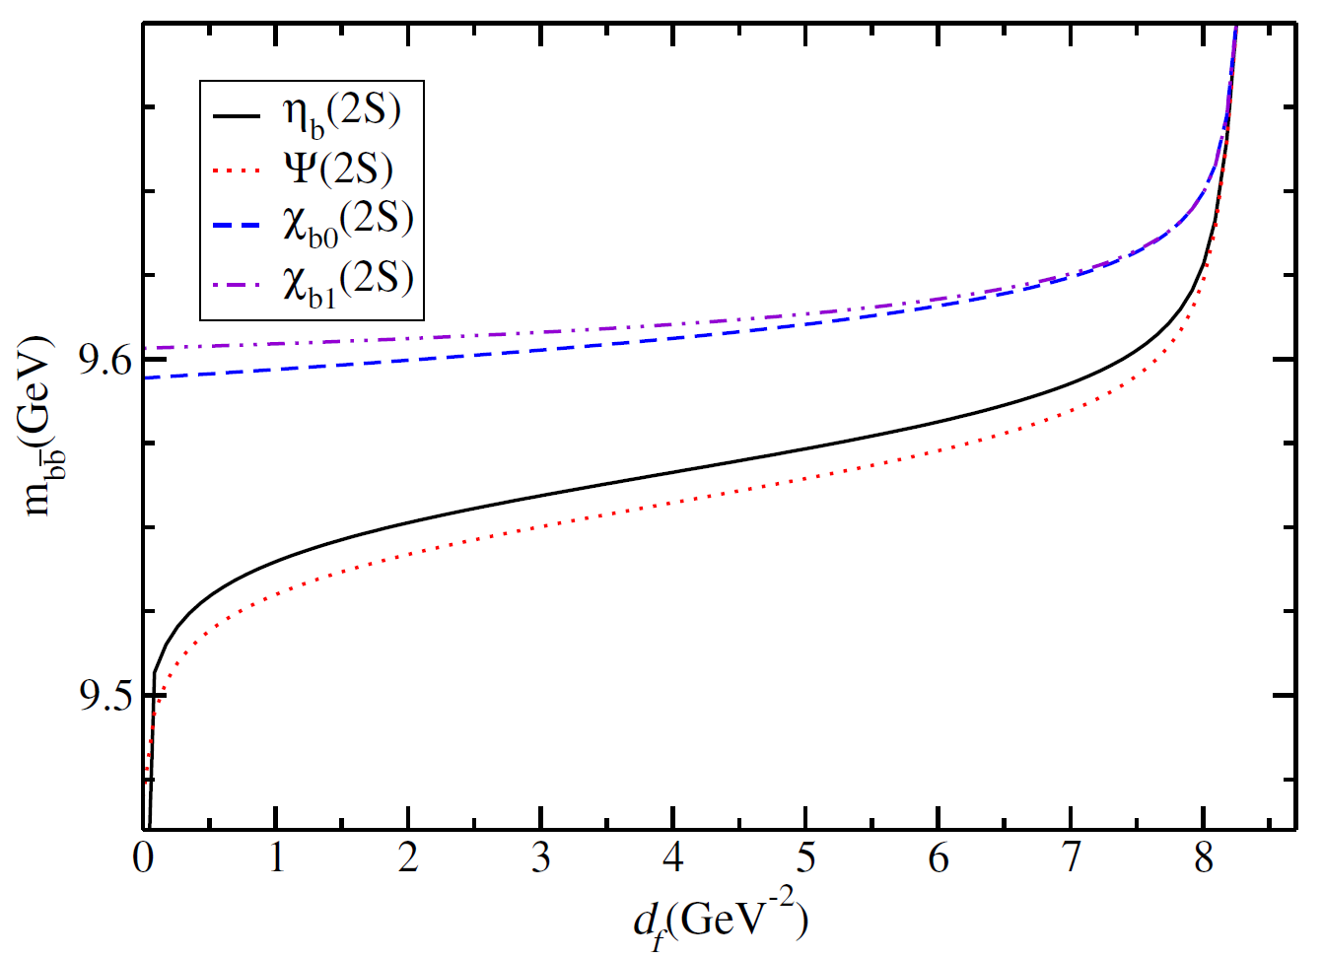
Excited States
M.A. Bedolla and E. Santopinto arxiv.org/abs/1807.01886v1
The evolution of the radial excitation’s mass with respect to the parameter:

Slide 27
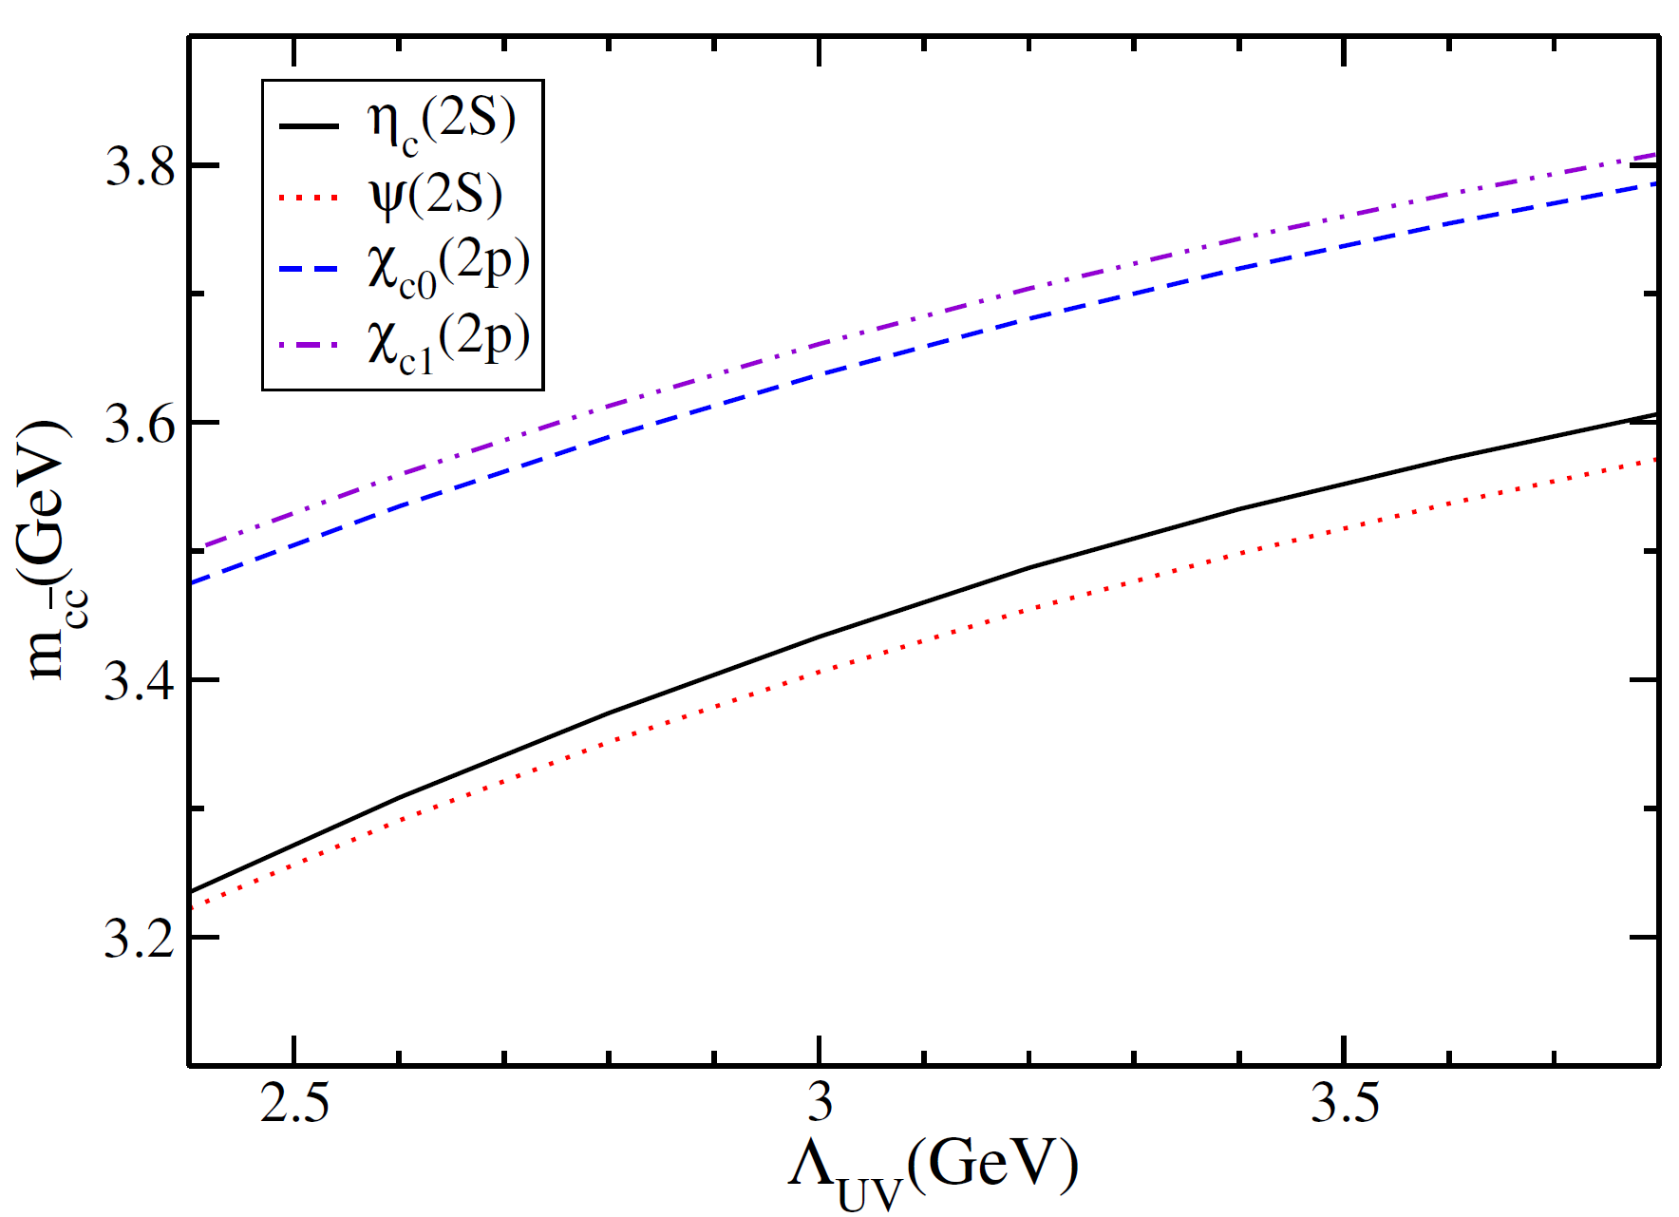

Excited States
M.A. Bedolla and E. Santopinto arxiv.org/abs/1807.01886v1
The evolution of the radial excitation’s mass with respect to the ultraviolet cutoff:

Slide 28
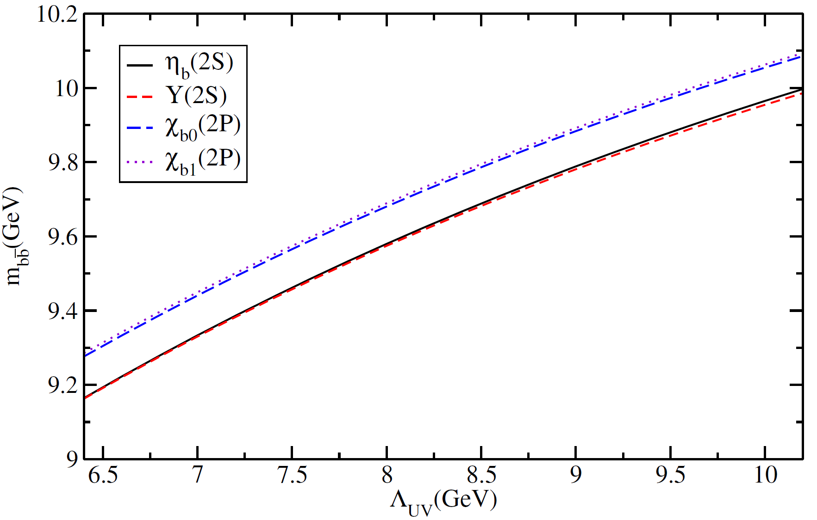
Excited States
M.A. Bedolla and E. Santopinto arxiv.org/abs/1807.01886v1
The evolution of the radial excitation’s mass with respect to the ultraviolet cutoff:

Slide 29
Excited states: Charmonia
M.A. Bedolla and E. Santopinto arxiv.org/abs/1807.01886v1
M_{c}=1690 | Λ_{UV}=3761 | Λ_{IR}=240 | m_{c}=1090 | α_{IR}=0.066
Masses in MeV | m_{ηc}(2S) | m_{J/Ψ} (2S) | m_{χc0}(2P) | m_{χc1}(2P)
PDG(2016) | (3639, ---) | (3686, 208) | ----- | -----
Contact Interaction | (3600, 296) | (3565, 205) | 3780 | 3803
Rojas (2014) | (3402, 63) | (3393, 147) | ----- | -----
Rojas (2014) | (3784, 62) | (3507, 162) | ----- | -----
Fischer (2015) | (3683, ---) | (3676, --- ) | 3833 | 3673
Hilger (2016) | (3508, 103) | (3553, 096) | ----- | 3523
Hilger (2016) | (3384, 89) | (3438, 121) | 3575 | 3420
Jain (1993) | (3470, ---) | (3700, ---) | ----- | -----
Bethe-Salpeter Amplitudes
E_{H} | 0.380 | 0.212 | 0.021 | 0.015
F_{H} | 0.123 | ----- | ----- | -----
Notes:
Ladina´mica del gluón no se afecta por la masa de quarks pesados
EL corte infrarrojo es una indicación de acoplamiento.

Slide 30
Excited states: Bottomonia
M.A. Bedolla and E. Santopinto arxiv.org/abs/1807.01886v1
M_{c}=4959 | Λ_{UV}=10170 | Λ_{IR}=240 | m_{b}=3800 | α_{IR}=0.006
Masses in MeV | m_{ηb}(2S) | m_{Υ}(2S) | m_{χb0}(2P) | m_{χb1}(2P)
PDG(2016) | (9999, ---) | (10023, 341) | 10232 | 10255
Contact Interaction | (9992, 163) | (9982, 157) | 10081 | 10090
Rojas (2014) | (-----, ---) | (9945, ---) | ----- | -----
Rojas (2014) | (-----, ---) | (9848, ---) | ----- | -----
Fischer (2015) | (9987, ---) | (10089, --- ) | 10254 | 10120
Hilger (2016) | (9820, 186) | (9838, 200) | 10004 | 9790
Hilger (2016) | (9728, 207) | (9754, 230) | 9917 | 9761
Bethe-Salpeter Amplitudes
E_{H} | 0.302 | 0.153 | 0.012 | 0.008
F_{H} | 0.078 | ----- | ----- | -----
Notes:
Ladina´mica del gluón no se afecta por la masa de quarks pesados
EL corte infrarrojo es una indicación de acoplamiento.

Slide 31
Final Remarks
The contact interaction is a simple model in such a way that the calculation of static and dynamic observables are performed in an analytical or semi-analytical way. These results can be compared and contrasted with “full QCD” and experiments.
The contact interaction includes important features of QCD, for example:
  Confinement.
  Ward identities and its consequences: Goldberger-Triemann relations.
  Dynamical chiral symmetry breaking.
  Gell-Mann-Oakes-Renner relations.

Slide 32
Final Remarks
With the contact interaction, masses of mesons and baryons composed with light quarks were calculated, as well as their first excited state with excellent results.
The contact interaction produces a parity partner of the ground state which is more massive than its first radial excitation. For example, for the nucleon, the first state J^{P} = ½⁻ is more massive than the second state J^{P} = ½⁺. This result has not been obtained by Lattice.
The form factors are harder than those provided by “full QCD” and experimental results.

Slide 33
Final Remarks
We used the contact interaction in order to describe the spectra of light , charm, bottom and heavy-light mesons successfully.
Generally, the coupling is a function of the larger mass scale (which is related to the quarks masses involved). Therefore, we can utilize the contact interaction to study mesons composed of light and heavy quarks.
We also calculated the weak decay constants of pseudoscalar and vector mesons, though these results does not fit well to experimental data.

Slide 34
Final Remarks
When it is possible to make a comparison, our results are in a good of agreement with experimental data and with models employing the SDE-BSE formalism that employ more sophisticated interaction kernels.
Moreover, we calculated the first radial excitations and decay constants of heavy quarkonia
With our results for mesons, we are planning to study tetraquarks in a contact interaction under a diquark-antidiquark picture.

Slide 35


