Slide 1


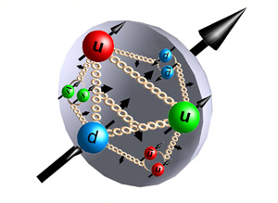



Structure of the nucleon’s low-lying excitations
CHEN CHEN
The Institute for Theoretical Physics,
Sao Paulo State University
(IFT- UNESP)

Slide 2
Non-Perturbative QCD:
Confinement & dynamical chiral symmetry breaking (DCSB)
Hadrons, as bound states, are dominated by non-perturbative QCD dynamics – Two emergent phenomena
  Confinement: Colored particles have never been seen isolated
  Explain how quarks and gluons bind together
  DCSB: Hadrons do not follow the chiral symmetry pattern
  Explain the most important mass generating mechanism for visible matter in the Universe
  Neither of these phenomena is apparent in QCD 's Lagrangian, HOWEVER, They play a dominant role in determining the characteristics of real-world QCD!

Slide 3

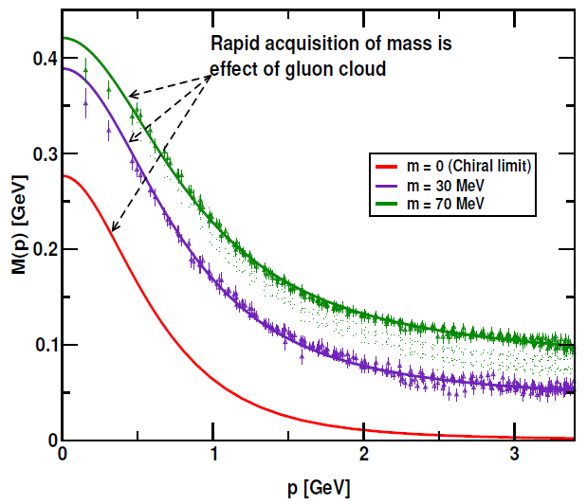
Non-Perturbative QCD:
Confinement & dynamical chiral symmetry breaking (DCSB)
From a quantum field theoretical point of view, these emergent phenomena could be associated with dramatic, dynamically driven changes in the analytic structure of QCD 's Schwinger functions (propagators and vertices).
Dressed-quark propagator:
  Mass generated from the interaction
  of quarks with the gluon.
  Light quarks acquire a HUGE constituent mass.
  Responsible of the 98% of the mass of the
  proton and the large splitting between
  parity partners.

Slide 4
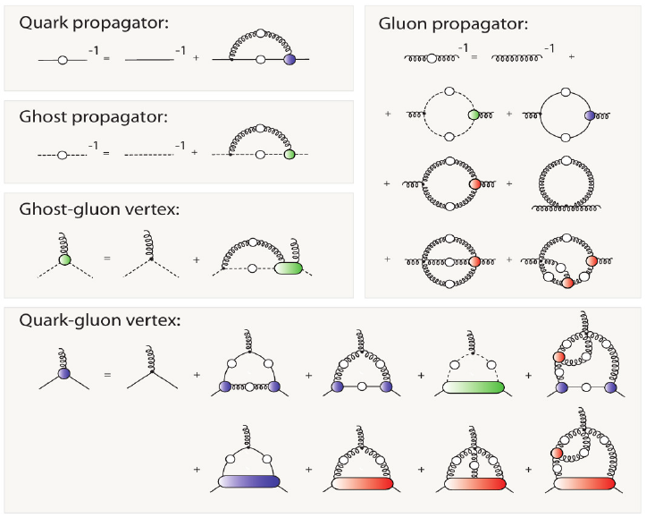
Dyson-Schwinger equations (DSEs)
The Schwinger functions are solutions of the quantum equations of motion (DSEs)

Slide 5
Dyson-Schwinger equations (DSEs)
Dyson-Schwinger equations
  A Nonperturbative symmetry-preserving tool for the study of Continuum- QCD
  Well suited to Relativistic Quantum Field Theory
  A method connects observables with long-range behaviour of the running coupling
  Experiment ↔ Theory comparison leads to an understanding of long-range behaviour of strong running-coupling

Slide 6
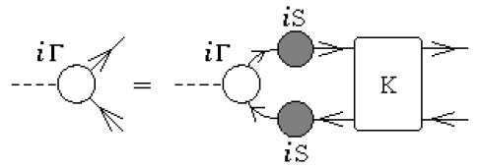
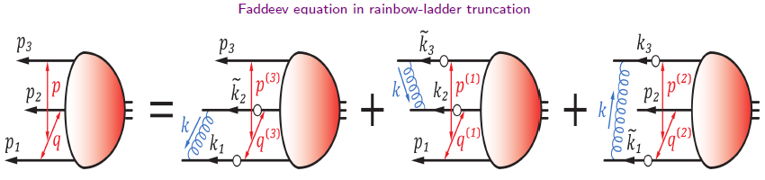
Hadrons: Bound-states in QFT
Mesons: a 2-body bound state problem in QFT
  Bethe-Salpeter Equation
  K - fully amputated, two-particle irreducible, quark-antiquark scattering kernel
Baryons: a 3-body bound state problem in QFT.
Faddeev equation: sums all possible quantum field theoretical exchanges and interactions that can take place between the three dressed-quarks that define its valence quark content.

Slide 7
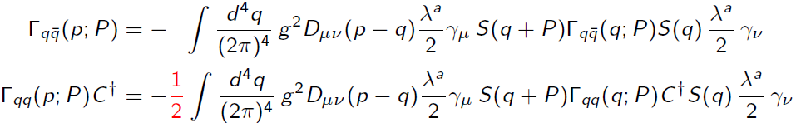
2-body correlations: diquarks
Mesons: quark-antiquark correlations -- color-singlet
Diquarks: quark-quark (diquark) correlations within a color-singlet baryon.
Diquark correlations:
  A tractable truncation of the Faddeev equation.
  In our approach: non-pointlike color-antitriplet and fully interacting.
  Diquark correlations are soft, they possess an electromagnetic size.
  Owing to properties of charge-conjugation, a diquark with spin-parity J^P may be viewed as a partner to the analogous J^{-P} meson.

Slide 8
2-body correlations: diquarks
Quantum numbers:
  (I=0, J^P=0^+): isoscalar-scalar diquark
  (I=1, J^P=1^+): isovector-pseudovector diquark
  (I=0, J^P=0^-): isoscalar-pesudoscalar diquark
  (I=0, J^P=1^-): isoscalar-vector diquark
  (I=1, J^P=1^-): isovector-vector diquark
  Tensor diquarks
Three-body bound states
Quark-Diquark two-body bound states

Slide 9
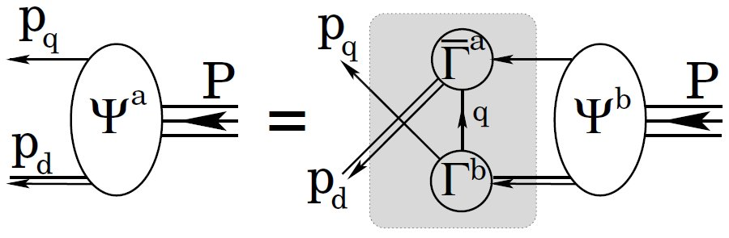
2-body correlations: diquarks
Quantum numbers:
  (I=0, J^P=0^+): isoscalar-scalar diquark
  (I=1, J^P=1^+): isovector-pseudovector diquark
  (I=0, J^P=0^-): isoscalar-pesudoscalar diquark
  (I=0, J^P=1^-): isoscalar-vector diquark
  (I=1, J^P=1^-): isovector-vector diquark
  Tensor diquarks
Three-body bound states
Quark-Diquark two-body bound states

Slide 10
QCD-kindred model
The dressed-quark propagator
Diquark amplitudes
Diquark propagators
Faddeev amplitudes

Slide 11

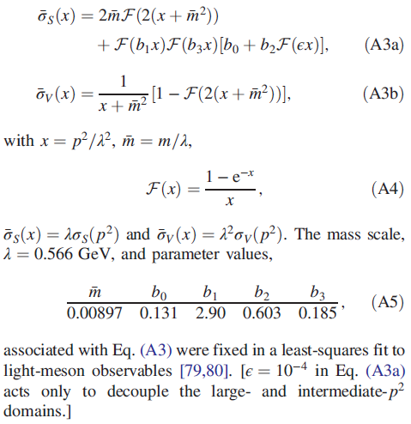
QCD-kindred model
The dressed-quark propagator
algebraic form:

Slide 12
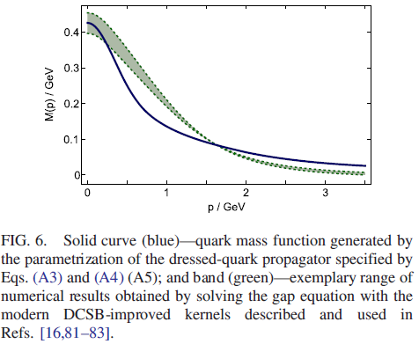
QCD-kindred model
The dressed-quark propagator
  Based on solutions to the gap equation that were obtained with a dressed gluon-quark vertex.
  Mass function has a real-world value at p^2 = 0, NOT the highly inflated value typical of RL truncation.
  Propagators are entire functions, consistent with sufficient condition for confinement and completely unlike known results from RL truncation.
  Parameters in quark propagators were fitted to a diverse array of meson observables. ZERO parameters changed in study of baryons.
  Compare with that computed using the
  DCSB-improved gap equation kernel (DB).
  The parametrization is a sound representation of contemporary
  numerical results, although simple and introduced
  long beforehand.

Slide 13
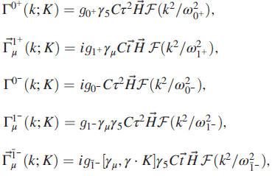
QCD-kindred model
Diquark amplitudes: five types of correlation are possible in a J=1/2 bound state: isoscalar scalar(I=0,J^P=0^+), isovector pseudovector, isoscalar pseudoscalar, isoscalar vector, and isovector vector.
The LEADING structures in the correlation amplitudes for each case are, respectively (Dirac-flavor-color),
Simple form. Just one parameter: diquark masses.
Match expectations based on solutions of meson and diquark Bethe-Salpeter amplitudes.

Slide 14

QCD-kindred model
Diquark masses (in GeV):
The first two values (positive-parity) provide for a good description of numerous dynamical properties of the nucleon, Δ-baryon and Roper resonance.
Masses of the odd-parity correlations are based on those computed from a contact interaction.
Such values are typical; and in truncations of the two-body scattering problem that are most widely used (RL), isoscalar- and isovector-vector correlations are degenerate.
Normalization condition → couplings:
Faddeev kernels: 22 × 22 matrices are reduced to 16 × 16 !

Slide 15
A parameter: gDB
There is an absence of spin-orbit repulsion owing to an oversimplification of the gluon-quark vertex when formulating the RL bound-state equations. We therefore employ a simple artifice in order to implement the missing interactions.
  We introduce a single parameter into the Faddeev equation for J^P=1/2^P baryons: gDB, a linear multiplicative factor attached to each opposite-parity (-P) diquark amplitude in the baryon’s Faddeev equation kernel.
  gDB is the single free parameter in our study.

Slide 16
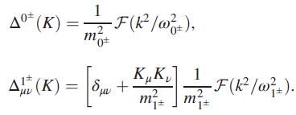
QCD-kindred model
The diquark propagators
The F-functions: Simplest possible form that is consistent with infrared and ultraviolet constraints of confinement (IR) and 1/q^2 evolution (UV) of meson propagators.
Diquarks are confined.
  free-particle-like at spacelike momenta
  pole-free on the timelike axis
  This is NOT true of RL studies. It enables us to reach arbitrarily high values of momentum transfer.

Slide 17
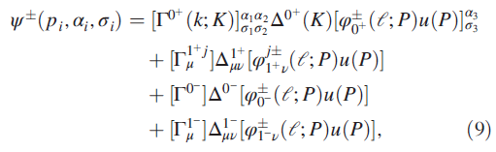
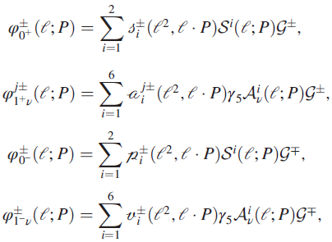
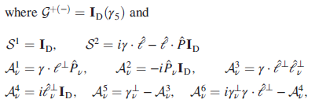
QCD-kindred model
The Faddeev ampitudes:
Quark-diquark vertices:

Slide 18
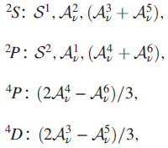
QCD-kindred model
Both the Faddeev amplitude and wave function are Poincare covariant, i.e. they are qualitatively identical in all reference frames.
Each of the scalar functions that appears is frame independent, but the frame chosen determines just how the elements should be combined.
In consequence, the manner by which the dressed quarks’ spin, S, and orbital angular momentum, L, add to form the total momentum J, is frame dependent: L, S are not independently Poincare invariant.
The set of baryon rest-frame quark-diquark angular momentum identifications:
The scalar functions associated with these combinations of Dirac matrices in a Faddeev wave function possess the identified angular momentum correlation between the quark and diquark.

Slide 19
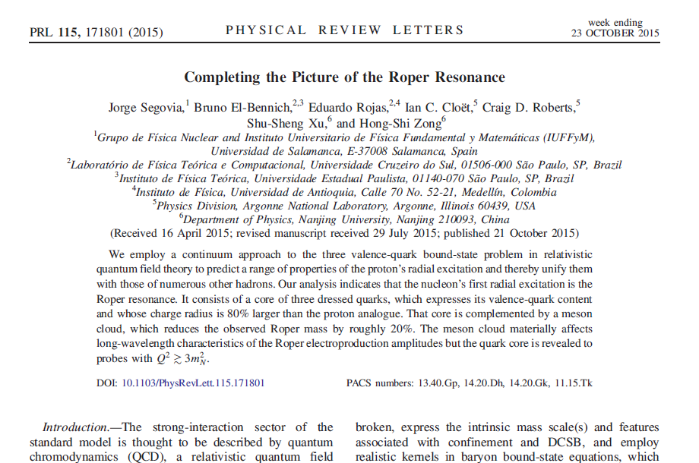
QCD-kindred model
Roper resonance -- solution to the 50 year puzzle

Slide 20
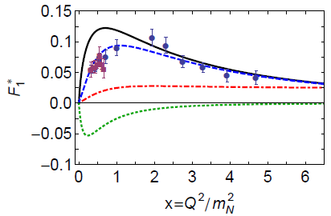
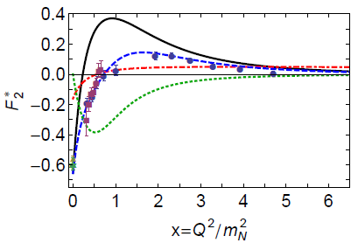
QCD-kindred model
Roper resonance -- solution to the 50 year puzzle

Slide 21
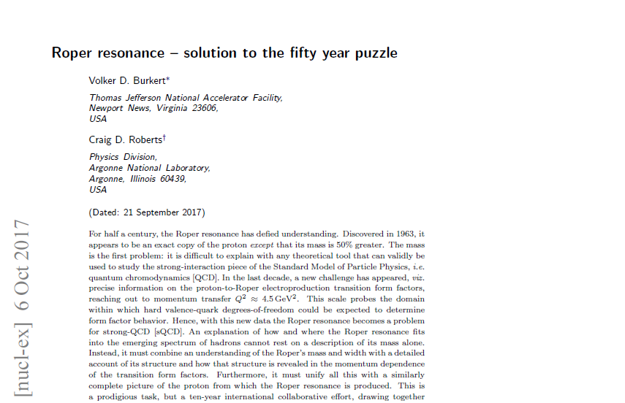
QCD-kindred model
Roper resonance -- solution to the 50 year puzzle

Slide 22
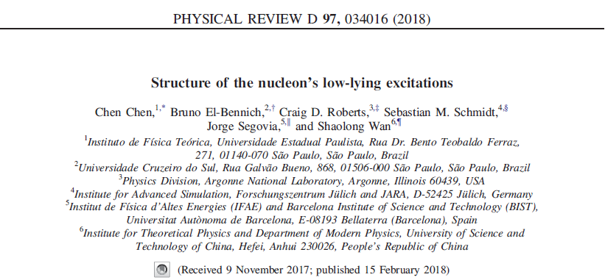
SOLUTIONS & THEIR PROPERTIES

Slide 23
SOLUTIONS & THEIR PROPERTIES
The four lightest baryon (I=1/2, J^P=1/2^{+-}) isospin doublets: nucleon, roper, N(1535), N(1650)
Masses
Rest-frame orbital angular momentum
Diquark content
Pointwise structure

Slide 24
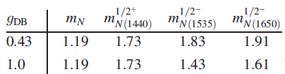
SOLUTIONS & THEIR PROPERTIES:
Masses
We choose gDB=0.43 so as to produce a mass splitting of 0.1 GeV between the lowest-mass P=- state and the first excited P=+ state, viz. the empirical value.
Our computed values for the masses of the four lightest 1/2^{+-} baryon doublets are listed here, in GeV:
Pseudoscalar and vector diquarks have no impact on the mass of the two positive-parity baryons, whereas scalar and pseudovector diquarks are important to the negative parity systems.
Although 1/2^- solutions exist even if one eliminates pseudoscalar and vector diquarks, 1/2^+ solutions do not exist in the absence of scalar and pseudovector diquarks.
It indicates that, with our Faddeev kernel, the so-called P-wave (negative-parity) baryons can readily be built from positive-parity diquarks.

Slide 25
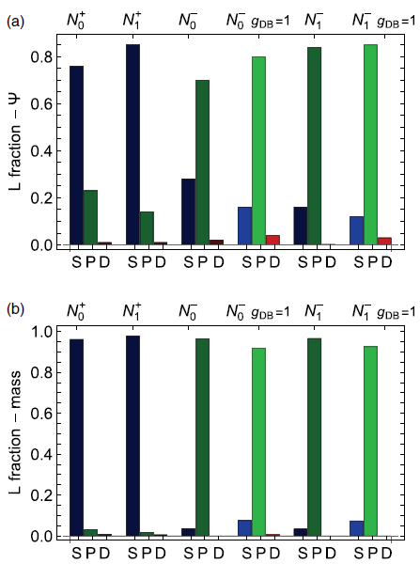
SOLUTIONS & THEIR PROPERTIES:
Rest-frame orbital angular momentum
(a) Computed from the wave functions directly.
(b) Computed from the relative contributions to the masses.
(b) delivers the same qualitative picture of each baryon’s internal structure as that presented in (a). Therefore, there is little mixing between partial waves in the computation of a baryon’s mass.

Slide 26
SOLUTIONS & THEIR PROPERTIES:
Rest-frame orbital angular momentum
The nucleon and Roper are primarily S-wave in nature, since they are not supported by the Faddeev equation unless S-wave components are contained in the wave function. On the other hand, the N(1535)1/2^-,N(1650)1/2^- are essentially P-wave in character.
These observations provide support in quantum field theory for the constituent-quark model classifications of these systems.

Slide 27
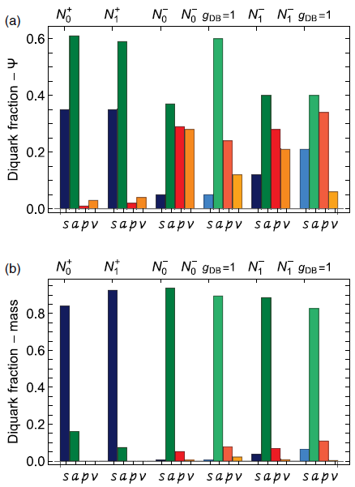
SOLUTIONS & THEIR PROPERTIES:
Diquark content
(a) Computed from the amplitudes directly.
(b) Computed from the relative contributions to the masses.
From (a): although gDB < 1 has little impact on the nucleon and Roper, it has a significant effect on the structure of the negative parity baryons, serving to enhance the net negative-parity diquark content. The amplitudes associated with these negative-parity states contain roughly equal fractions of even and odd parity diquarks.
From (b): In each case depicted in the lower panel, there is a single dominant diquark component. There are significant interferences between different diquarks.

Slide 28
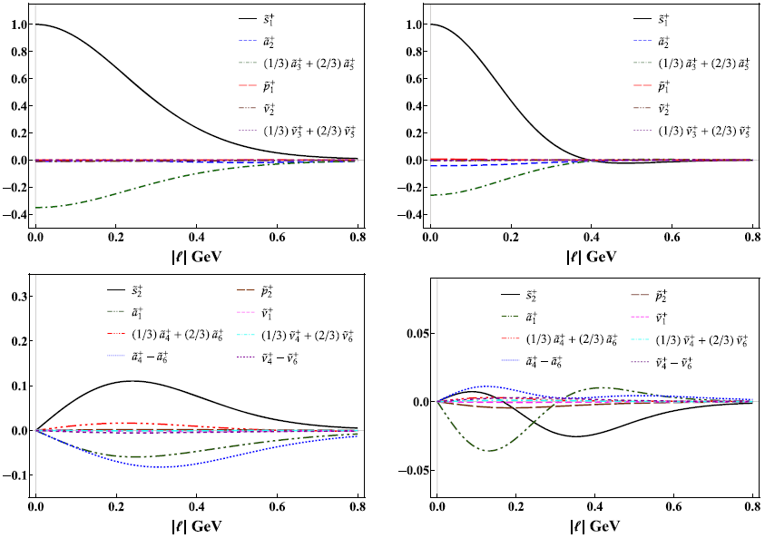
SOLUTIONS & THEIR PROPERTIES:
Pointwise structure
We consider the zeroth Chebyshev moment of all S- and P-wave components in a given baryon’s Faddeev wave function.
Nucleon’s first positive-parity excitation: all S-wave components exhibit a single zero; and four of the P-wave projections also possess a zero. This pattern of behavior for the first excited state indicates that it may be interpreted as a radial
excitation.

Slide 29
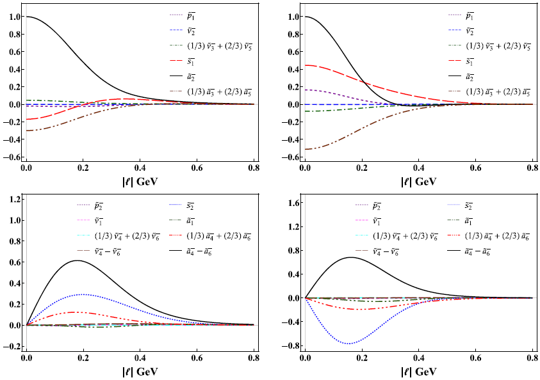
SOLUTIONS & THEIR PROPERTIES:
Pointwise structure
For N(1535)1/2^-,N(1650)1/2^- : the contrast with the positive-parity states is stark.
In particular, there is no simple pattern of zeros, with all panels containing at least one function that possesses a zero.
In their rest frames, these systems are predominantly P-wave in nature, but possess material S-wave components; and the first excited state in this negative parity channel—N(1650)1/2^−—has little of the appearance of a radial excitation, since most of the functions depicted in the right panels of the figure do not possess a zero.

Slide 30
Summary & Outlook
By including all kinds of diquarks, we performed a comparative study of the four lightest baryon (I=1/2, J^P=1/2^{+-}) isospin doublets in order to both elucidate their structural similarities and differences.
The first ON-SHELL DSE treatment of these systems.
The two lightest (I=1/2, J^P=1/2^+) doublets are dominated by scalar and pseudovector diquarks; the associated rest-frame Faddeev wave functions are primarily S-wave in nature; and the first excited state in this 1/2^+ channel has very much the appearance of a radial excitation of the ground state.
In the two lightest (I=1/2, J^P=1/2^-) systems, TOO, scalar and pseudovector diquarks play a material role. In their rest frames, the Faddeev amplitudes describing the dressed-quark cores of these negative-parity states contain roughly equal fractions of even and odd parity diquarks; the associated wave functions of these negative-parity systems are predominantly P-wave in nature, but possess measurable S-wave components; and, the first excited state in this negative parity channel has little of the appearance of a radial excitation.
NEXT: N(1720)3/2^+, N(1520)3/2^-, baryons with strangeness, form factors, PDAs, PDFs, …

Slide 31

Thank you!

Slide 32
Quark-diquark picture
A baryon can be viewed as a Borromean
bound-state, the binding within which
has two contributions:
  Formation of tight diquark correlations.
  Quark exchange depicted in the shaded
  area.
The exchange ensures that diquark correlations within the baryon are fully dynamical: no quark holds a special place.
The rearrangement of the quarks guarantees that the baryon's wave function complies with Pauli statistics.
Modern diquarks are different from the old static, point-like diquarks which featured in early attempts to explain the so-called missing resonance problem.
The number of states in the spectrum of baryons obtained is similar to that found in the three-constituent quark model, just as it is in today's LQCD calculations.

Slide 33
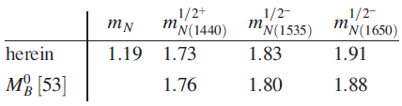
SOLUTIONS & THEIR PROPERTIES:
Masses
The quark-diquark kernel omits all those resonant contributions which may be associated with meson-baryon final-state interactions that are resummed in dynamical coupled channels models in order to transform a bare baryon into the observed state.
The Faddeev equations analyzed to produce the results should therefore be understood as producing the dressed-quark core of the bound state, not the completely dressed and hence observable object.
In consequence, a comparison between the empirical values of the resonance pole positions and the computed masses is not pertinent. Instead, one should compare the masses of the quark core with values determined for the meson-undressed bare excitations, e.g.,
where M^0_B is the relevant bare mass inferred in the associated dynamical coupled-channels analysis.
Notably, the relative difference between our predicted quark core masses and the relevant bare mass inferred in the associated dynamical coupled-channels analysis is just 1.7%, even though no attempt was made to secure agreement. We consider this to be a success of our formulation of the bound-state problem for a baryon’s dressed-quark core.

