Slide 1
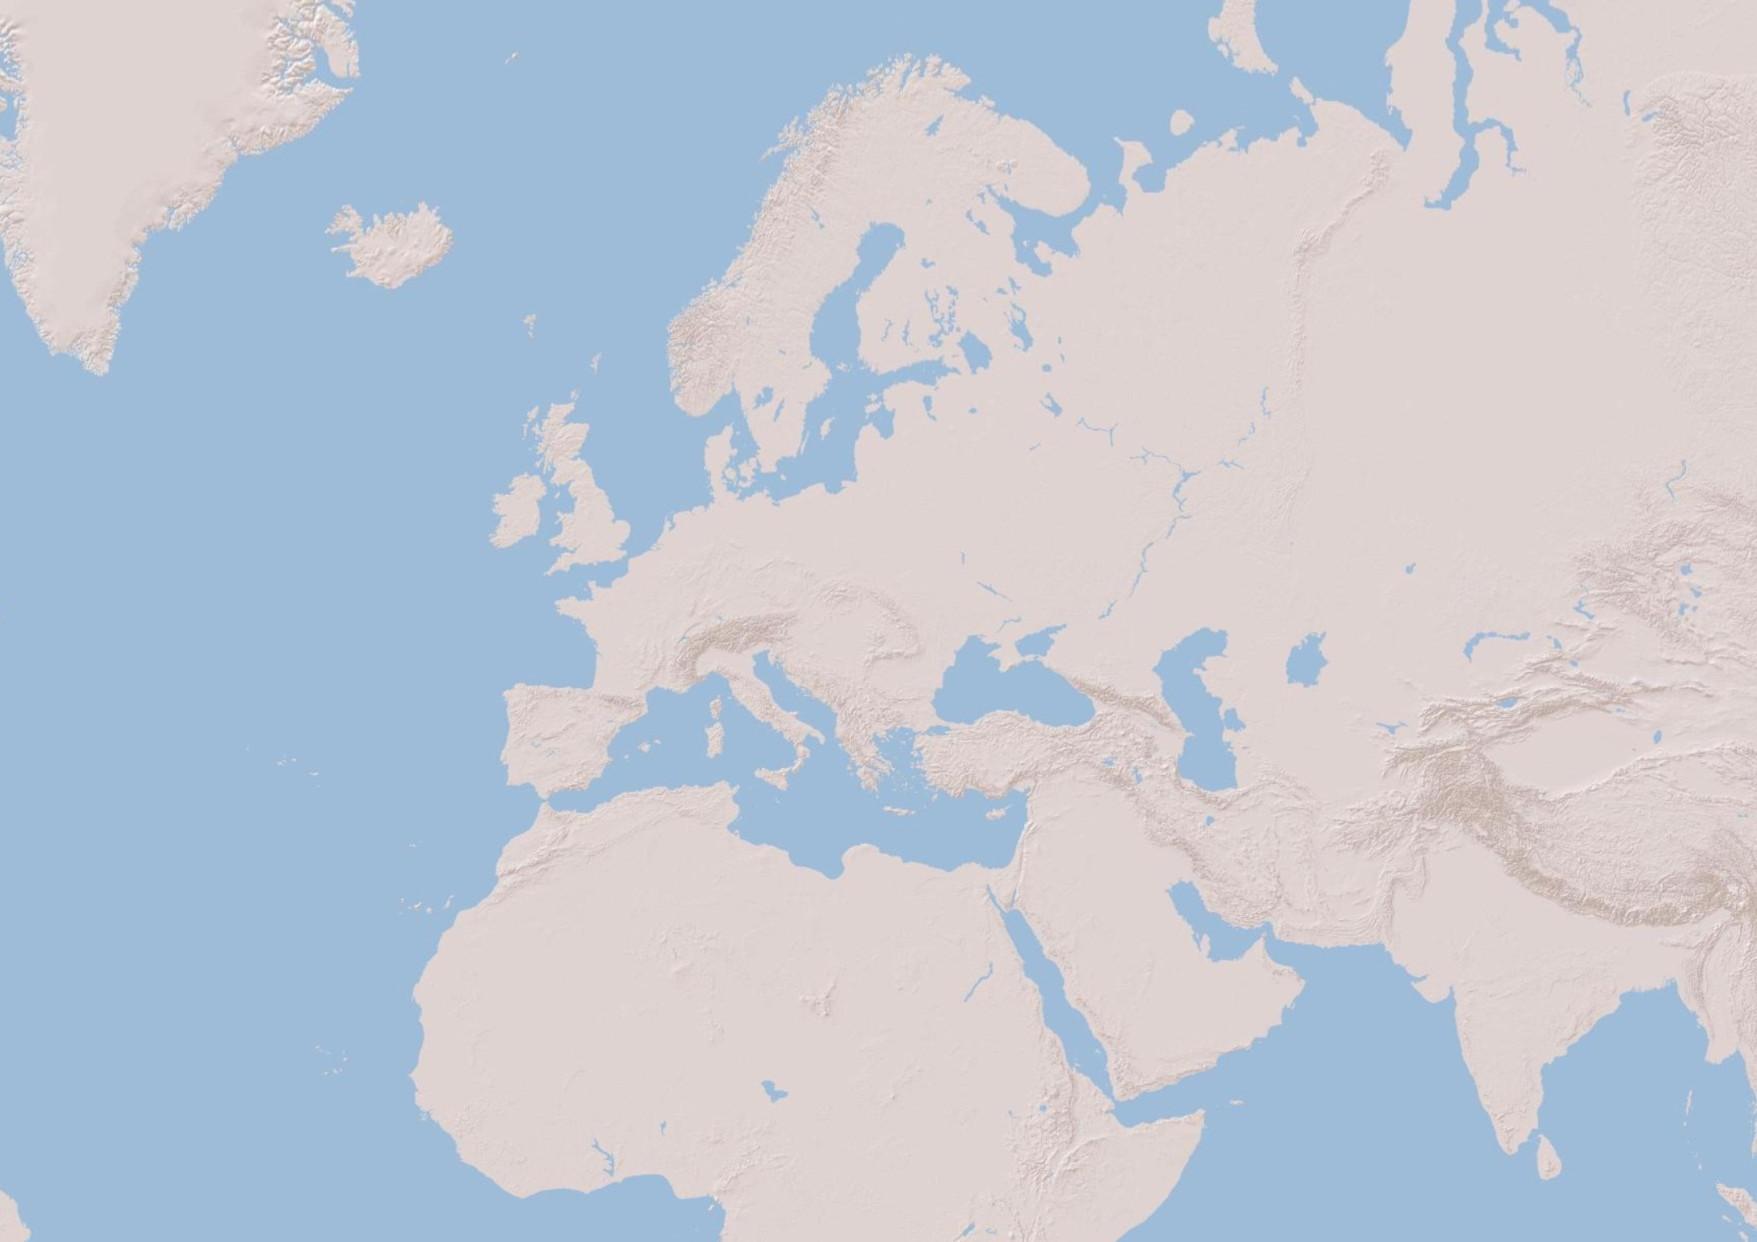
DIGITAL ELEVATION MODEL (Sources: Esri, DeLorme, USGS, NPS)

Slide 2
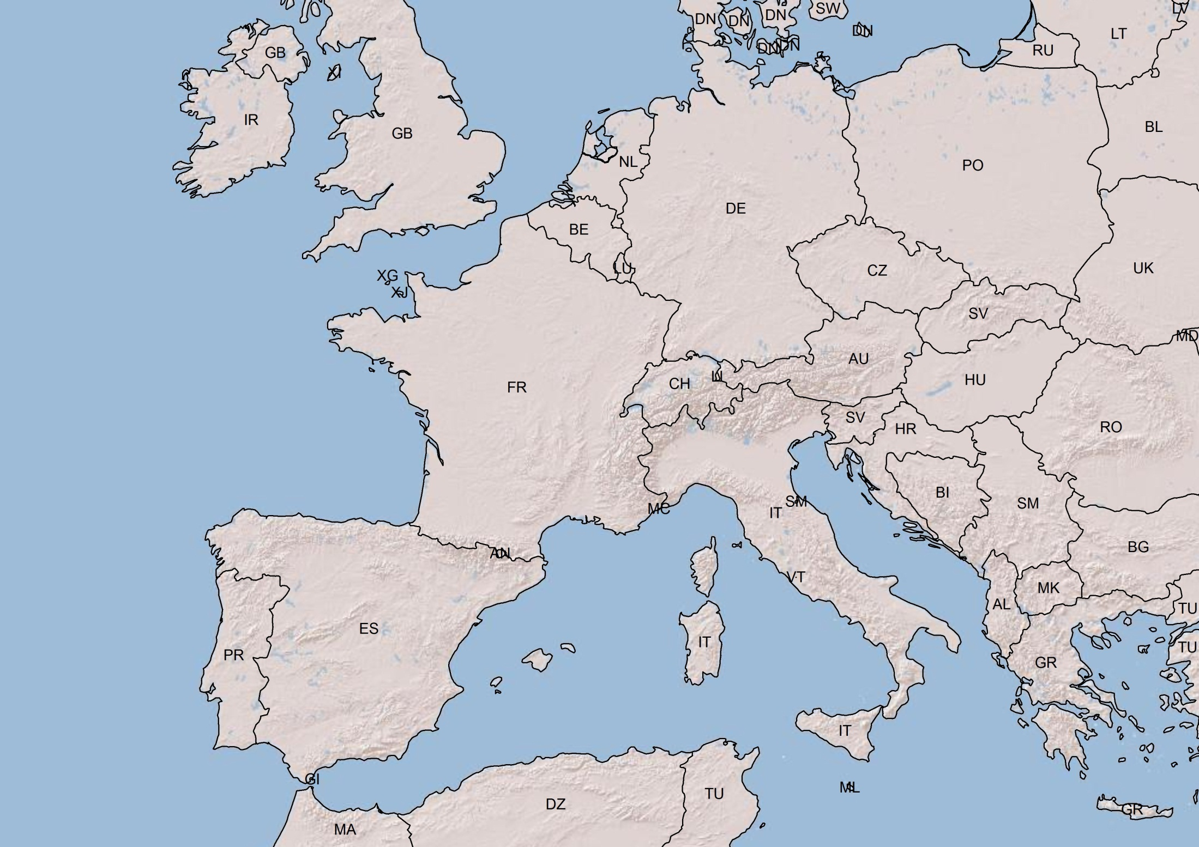
DIGITAL ELEVATION MODEL (Sources: Esri, DeLorme, USGS, NPS)

Slide 3
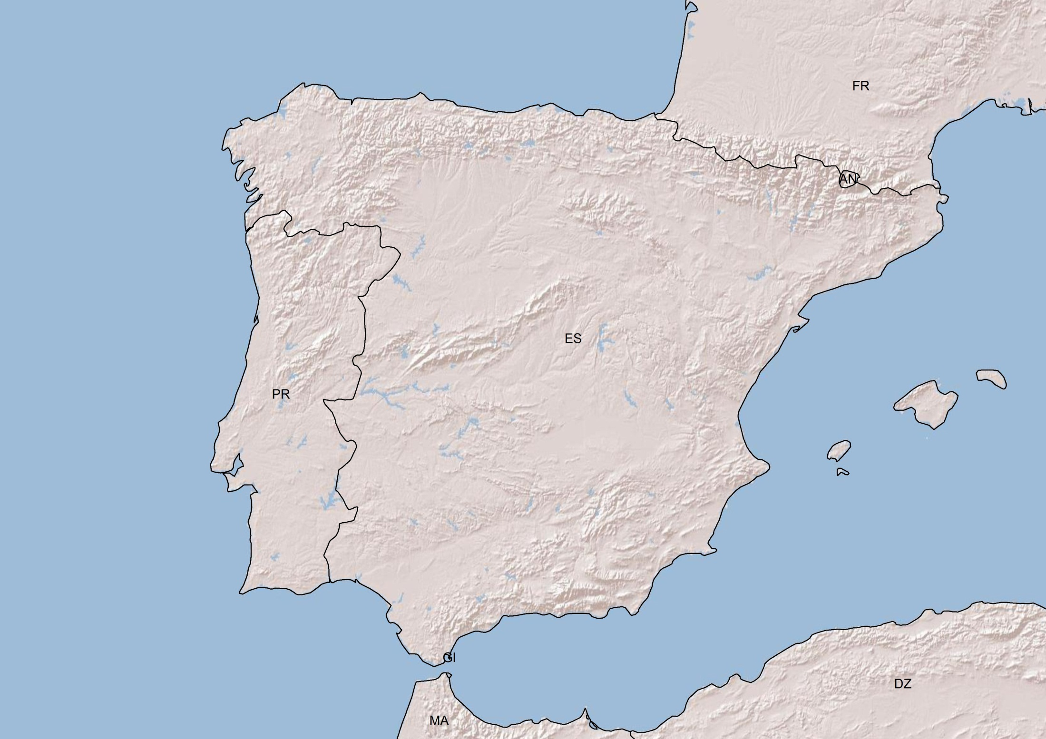
DIGITAL ELEVATION MODEL (Sources: Esri, DeLorme, USGS, NPS)

